Slide 1


PRESENTATION ON
FOOD TRACK
By - Ravi Kumar

Slide 2




PROJECT OVERVIEW
Food Track is an online platform that allows train travelers to order food from various restaurants available at specific station. The purpose is to provide quality and timely food delivery during train journeys. The system lists restaurants and their food items for each station, allowing customers to place orders based on their route. Built using the MVC Pattern, this project efficiently manages data and offers a user-friendly experience.

Slide 3









MEET THE GROUP
RAVI KUMAR
DIVYA SONDAGAR
RAJESH SIR

Slide 4








PROJECT GOALS
Offer a variety of food options across different stations.
Provide a user-friendly platform
Simplify food ordering for train travellers.

Slide 5











Methodology
Project Requirements Analysis
Using MVC Architecture
Implementing Core Features
Designing the Database
Testing and Debugging
Deployment Process

Slide 6






System Architecture
Basic flow of MVC architecture:
Model: Represents stations, restaurants and menu items
View: Front-End where users place orders
Controller: Handles requests and coordinates between model and view

Slide 7
WORK FLOW
User browses available restaurants
User selects food item and places order
Order notification to restaurants
Order preparation and status update
Delivery at train station

Slide 8



TECHNOLOGY STACK
Front-end: HTML, CSS, Bootstrap
Back-end: PHP
Database: MySQL
Payment integration: Multiple payment gateways like UPI debit/credit cards, net banking

Slide 9

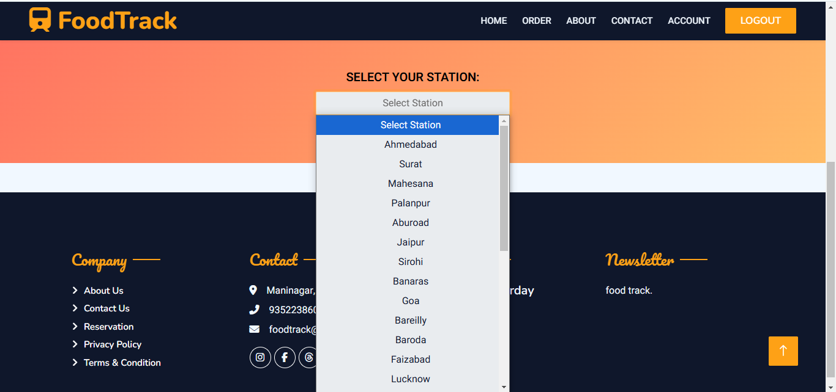

DEMO

Slide 10

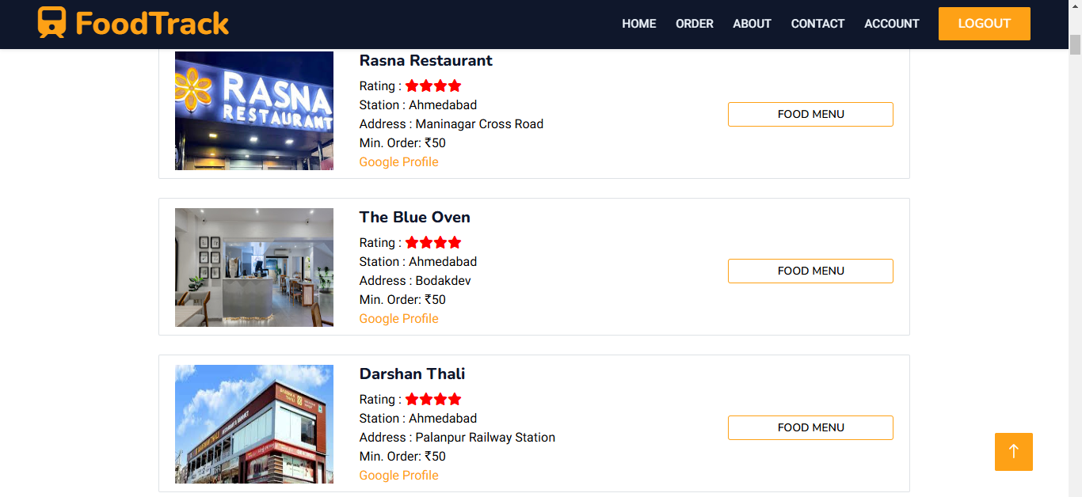


Slide 11
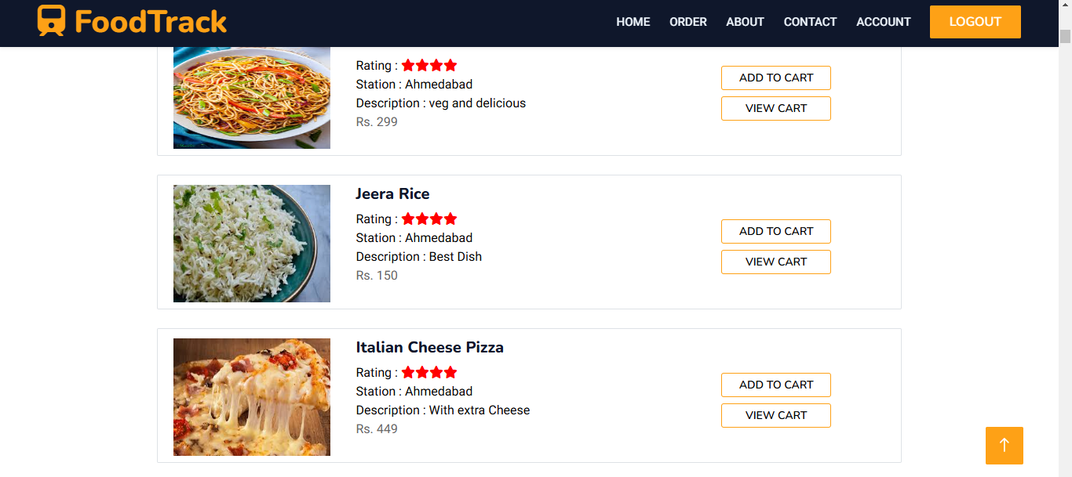

Slide 12
CONCLUSION
The Food Track is designed to make food ordering easy and accessible for train passengers. This project enables users to browse menus from multiple restaurants at various stations, place orders conveniently, and receive their meals at their seats during the journey. Built on the Laravel MVC framework, it ensures a secure, scalable, and flexible structure that can handle multiple stations, restaurants, and orders efficiently. This system has the potential to enhance the travel experience by providing a reliable and enjoyable food service, with room for future improvements like real-time tracking, online payments, and additional restaurant options.

Slide 13



THANK Y U

